Slide 1


IMDB MOVIE ANALYSIS
With the help of the data provided , performing various statistical , mathematical operations in order to do descriptive analysis of the data.
Manipulating the data in order to get the required information cleaning the data.
Providing key insights of the movie and cast in order to know customer’s views and movie’s performance in theatre.
-SUMMIT TABHANE

Slide 2


OVERVIEW:-
After data cleaning and data processing , performing statistical operations to get average , median , mode , variance. Tasks performed in the project like :-
Movie Genre Analysis
Movie duration Analysis
Language Analysis
Director Analysis
Budget Analysis

Slide 3
MOVIE GENRE ANALYSIS
Finding out the most common genres of movie .
Firstly , splitting the genres of the movie with the help of text to column as genres were separated by “ | ” sign .
This splitting was done in order to know all the genres of the movies
As genres splitted to multiple columns , counting the cells for each of the specific genres
Similarly calculating genres used in the movies
=COUNTIF(J5:P5002,"Drama")

Slide 4
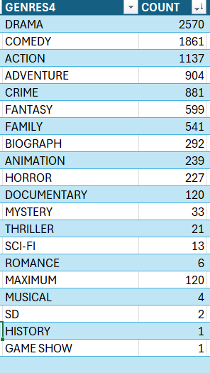
OUTPUT:-
It was found that most of the movies were from the drama genre
Descriptive analysis was performed with the help of statistical functions like averageif , median , mode , variance .
average

Slide 5
MOVE DURATION ANALYSIS :-
Function | Values
MEAN | 1.781526
MEDIAN | 1.716667
VARIANCE | 0.186108
MIN | 0
MAXIMUM | 8.516667
How duration of the movie affects the score on imdb.
Calculating the descriptive data from the movie duration.
average.
Below table shows the descriptive stats of duration.

Slide 6
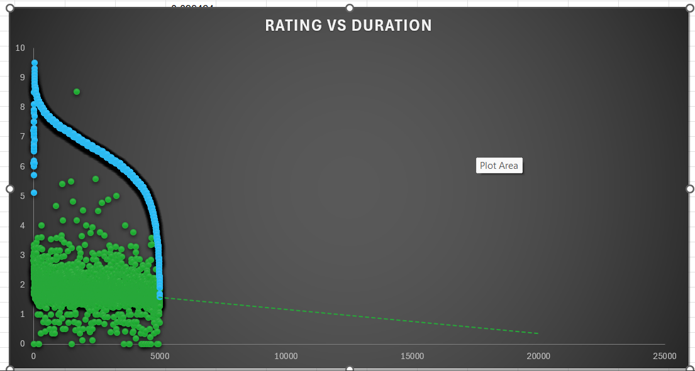
RELATION BETWEEN DURATION & RATINGS
From the graph we can visualize that movie with longer duration have less rating , rating keeps on getting low as the duration of the movie is increased.

Slide 7
LANGUAGE ANALYSIS
The objective of this analysis is to examine the distribution of movies based on their language and assess the impact of language on IMDB scores using descriptive statistics.
By identifying the most common languages used in movies and analyzing their corresponding IMDB ratings, we aim to uncover potential patterns or trends in audience preferences and critical reception.
To categorize data we can either use slicer or with the use of pivot tables we can evaluate language of movies.
Through statistical function we can calculate by using
=countif(range,”language”)

Slide 8
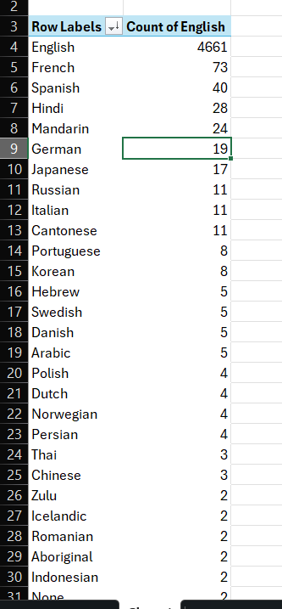
With the help of pivot table insert the language column in the cell.
In values add sum of language.
To know the relation between language and IMDB score
=AVERAGEIF(U3:U5000, "English", AB3:AB5000)
Similarly average can be calculated for all the language.
LANGUAGE | SCORE
ENGLISH | 6.397232
FRENCH | 7.038356
SPANISH | 6.9375
HINDI | 6.632143
MANDARIN | 6.7875
GERMAN | 7.342105
JAPANESE | 7.347059
RUSSIAN | 6.363636
ITALIAN | 7.227273

Slide 9

DIRECTOR ANALYSIS:-
Calculation of the average IMDB score of director .
To perform this analysis we can use pivot table to use the selected columns separately.
We can use director & IMDB score of the director in pivot table for further classification .
The query provided above can be used to find out percentile once we make the pivot table to get the percentile.
Other way can also be followed by simply sorting the Average IMDB score in descending order , this helps to know the score in an order.
=PERCENTILE.INC(B2:B2402,0.9)

Slide 10
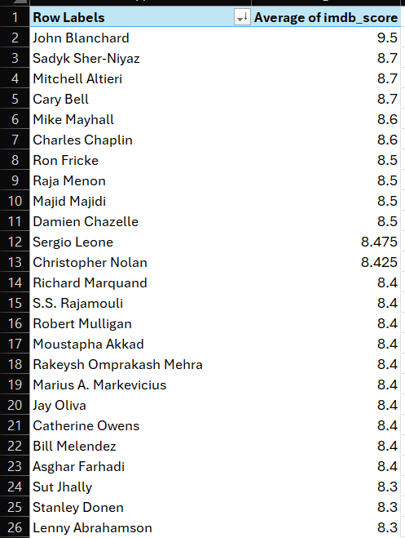
AVG DIRECTOR SCORE
The data from the pivot table is then sorted in descending order , to identify director with highest IMDB score.

Slide 11
BUDGET ANALYSIS:-
AIM is to know which movie made highest profit.
To calculate the profit made by movie producer we hace to calculate the difference of gross earning and budget of the movie.
Simply do the mathematical operation and drag the cell to get the profit status of each and every movie.
To search about the movie which made highest profitability we used MAX() function in which we choose range of the profitability column.
It was found that AvatarÂ had the maximum profit of 523505847

